Slide 1
Crime and Unemployment
How do they vary over the Past 10 years?
November 11, 2021
Jamie Mortensen, heather Leighton-Dick

Slide 2
Introduction and definition of terms
We hypothesized that property crime counts might vary similarly to the unemployment rate in the United States
We extracted data from the FBI Crime Data Explorer API and the Bureau of Labor Statistics Public Data API
We collected statistics on national property crime counts with the unemployment rate and limited to a window of the past 10 years

Slide 3
Crime Definitions
property crime: a category of crime, usually involving private property, that includes burglary, larceny, theft, motor vehicle theft, arson, shoplifting, and vandalism
burglary: entry into a building with the intent to commit a crime, most often theft, robbery, or murder
robbery: taking property unlawfully from a person or place by force or threat of force
larceny: the theft of physical items that are personal property, without threat of force (theft includes all variations on stealing property from another person or entity)
stolen property offense: actions taken with property known to be stolen

Slide 4
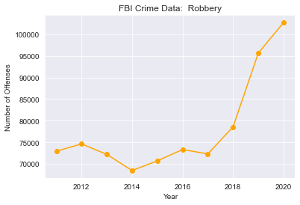
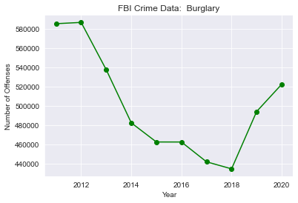
Property crime Stats

Slide 5
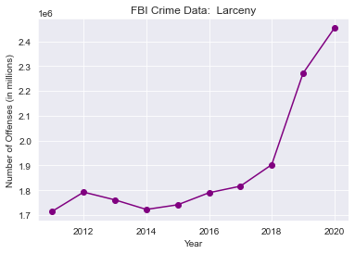
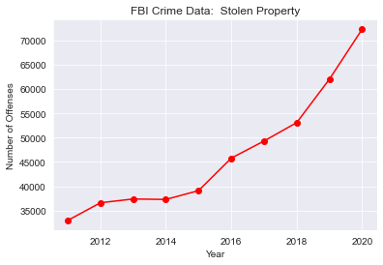
Property Crime Stats Cont.

Slide 6
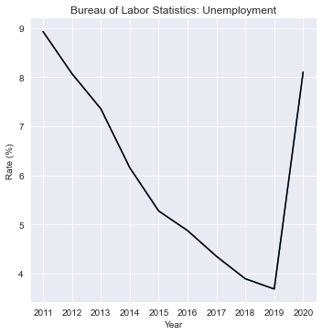
Unemployment rate

Slide 7
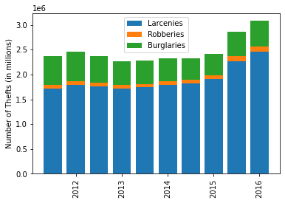
Comparisons

Slide 8
lessons learned
1) Be careful of data that isn't labeled clearly; for example, "value" in the unemployment data was extremely vague and required extra research.
2) It follows from the first point, but information literacy is important. It's not enough to be able to manipulate the data; we have to be able to figure out what data has been included and whether the labels are accurate (in the course of the project, some data were represented as is more usual in the statistics and economics fields as a way of abbreviating large numbers "normalized x100,000").
3) Sometimes data will be stored using unfamiliar python modules, like "prettytable," which needs to be downloaded in addition to the usual suspects.

